Slide 1
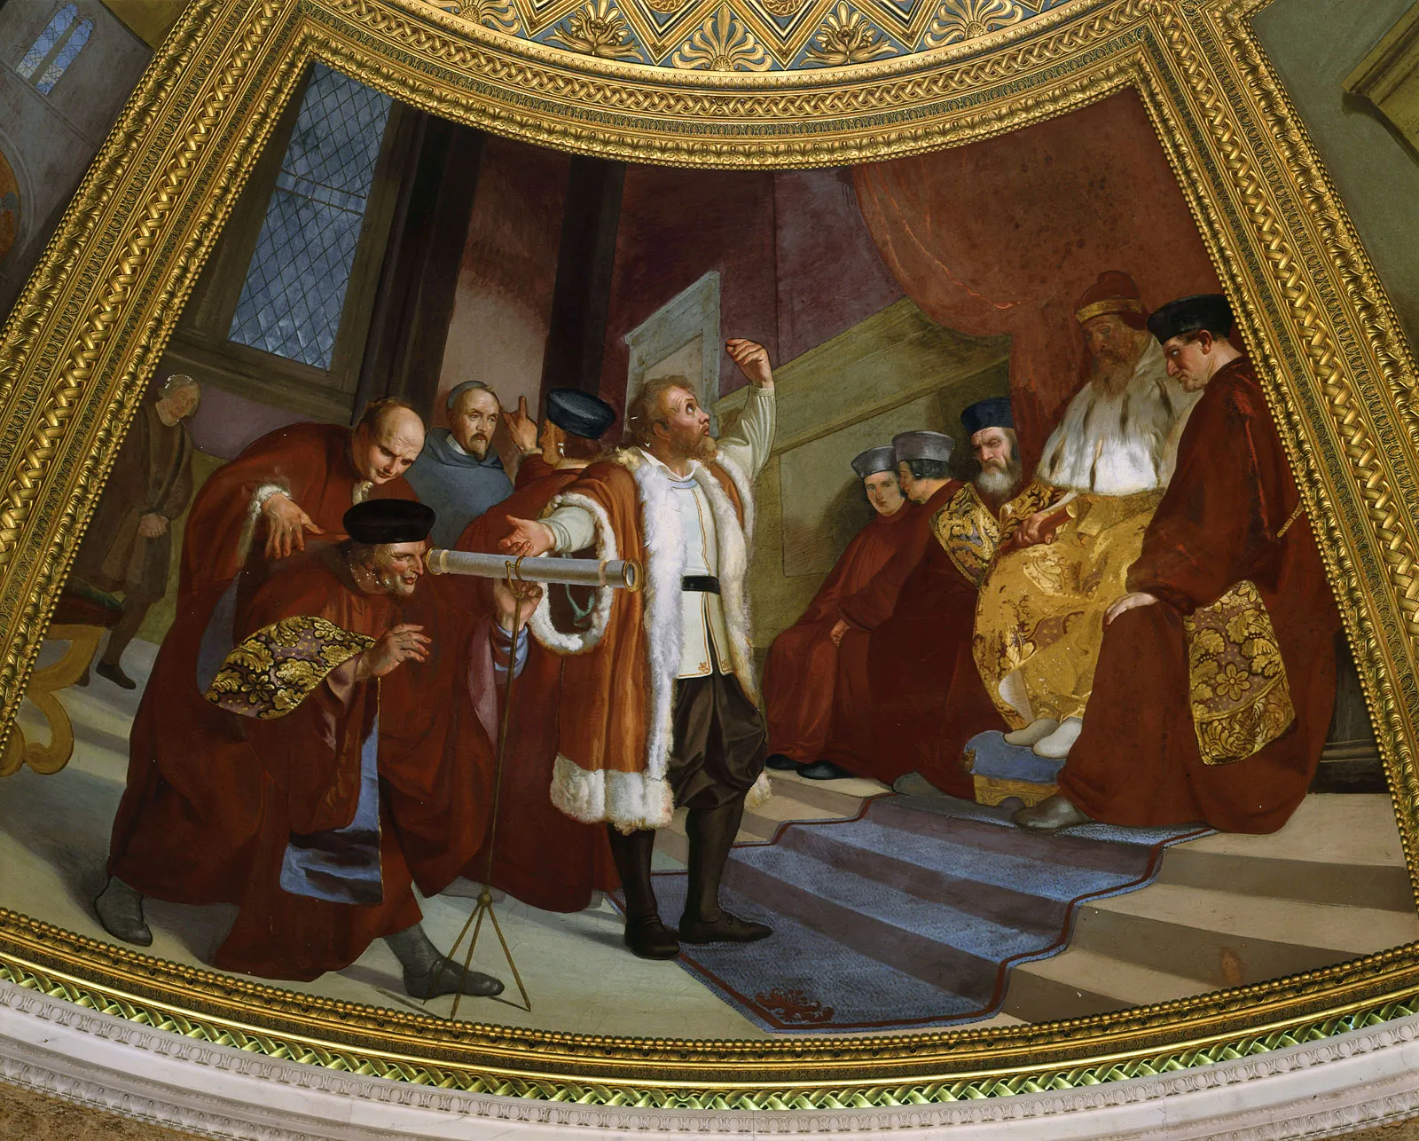
Replication/Revision/Rejection
Conclusion
L(M|D) ∝ P(D|M) Frequentist
P(M|D) ∝ P(D|M) · P(M) Bayesian
Causal claim
Causal effects Explanations
Causal inference
Galileo Galilei (1564-1642) the “father of modern science”
Data
Model
Inference algorithm
Statistical inference Machine learning
Observations
Predictions
P(D|M)
Natural process
Causal model
DGP model
Probability theory
Inductive reasoning
Real world
Abstract world
Propositional logic Deductive reasoning
Empiricism
Rationalism
Notes:
A probability model is the triplet (Ω, σ-algebra, P)
Generative vs Discriminative

Slide 2
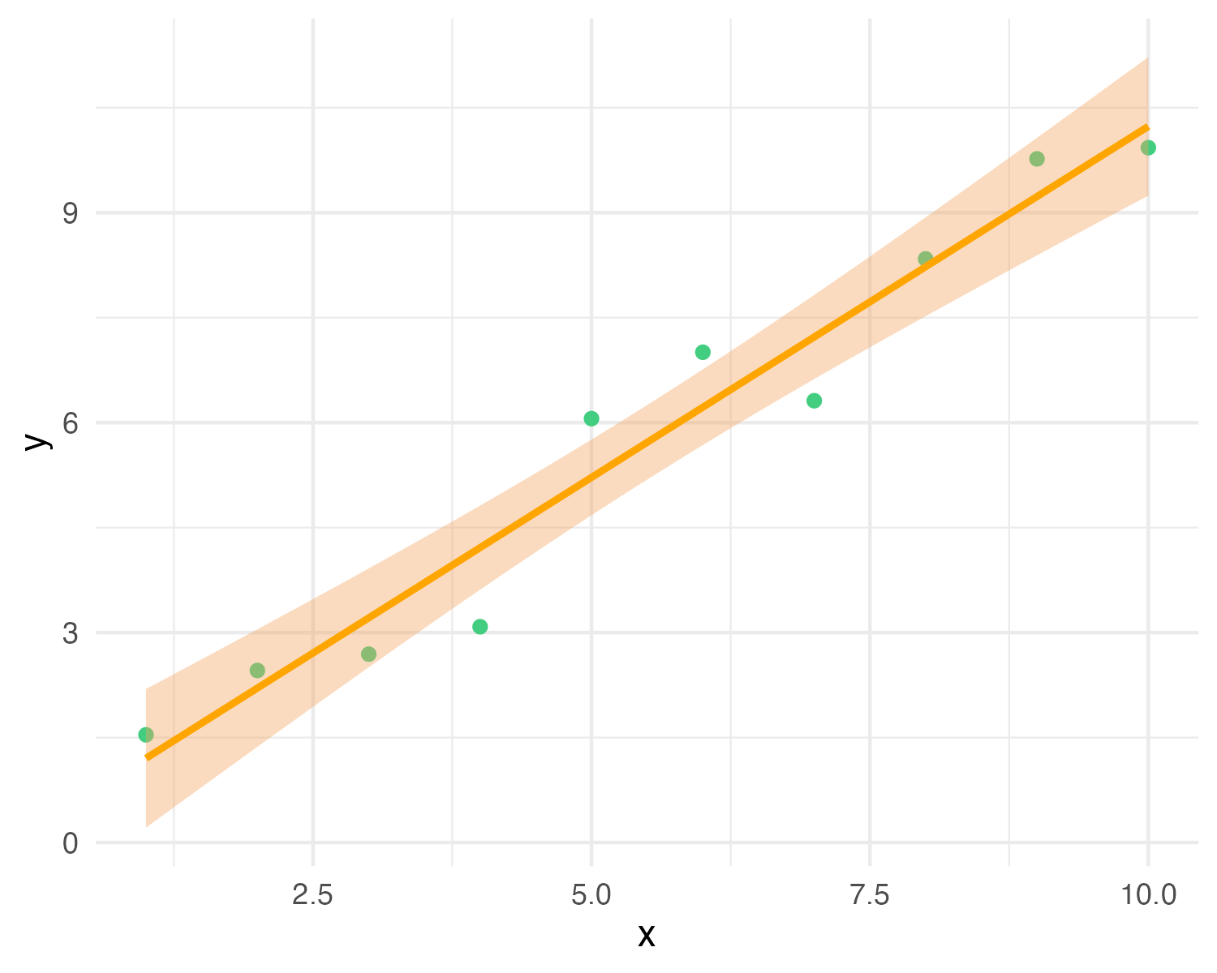
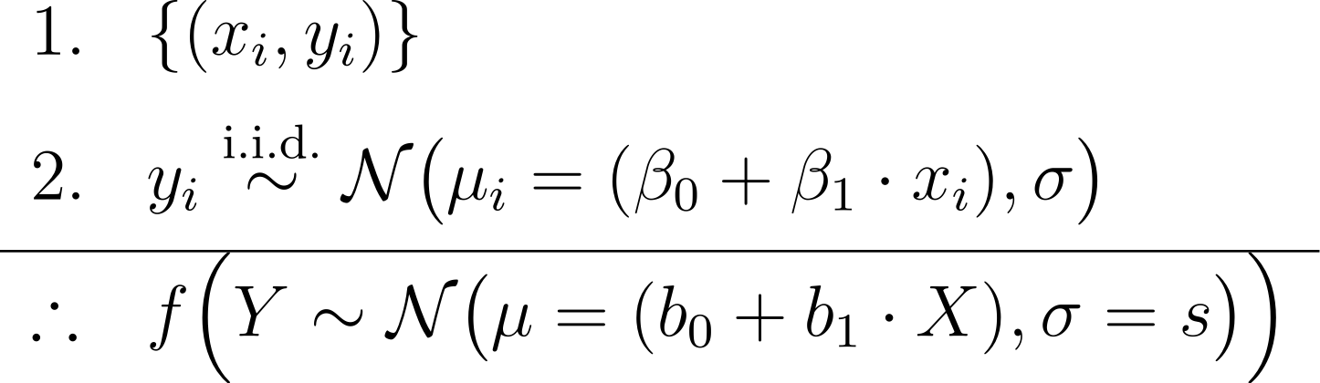
y_{i} ∼ N(μ_{i} = (β₀ + β₁ · x_{i}), σ)
premises assumptions evidence KB
premises
data
causal model
conclusion
likelihood (+ prior)
estimator
Y = b₀ + b₁X with CI
MLE (or posterior) predictive model
effect
= conclusion claim hypothesis query
Notes:
In Bayesian inference we add priors to the premises, and obtain a joint posterior distribution of the parameters conditioned on the data p(beta0, beta1, sigma | data), or a posterior predictive distribution as conclusion
In frequentist inference we obtain maximum-likelihood estimates of the parameters (b0, b1, s)
https://latex.unacademy.com/
\begin{array}{ll}
1. & \{(x_i, y_i)\} \\[6pt]
2. & y_i \stackrel{\text{i.i.d.}}{\sim} \mathcal{N}\bigl(\mu_i = (\beta_0 + \beta_1 \cdot x_i), \sigma\bigr) \\[4pt]
\hline
\therefore & f \Bigl(Y \sim \mathcal{N}\bigl(\mu = (b_0 + b_1 \cdot X), \sigma = s\bigr)\Bigr) \\
\end{array}

Slide 3
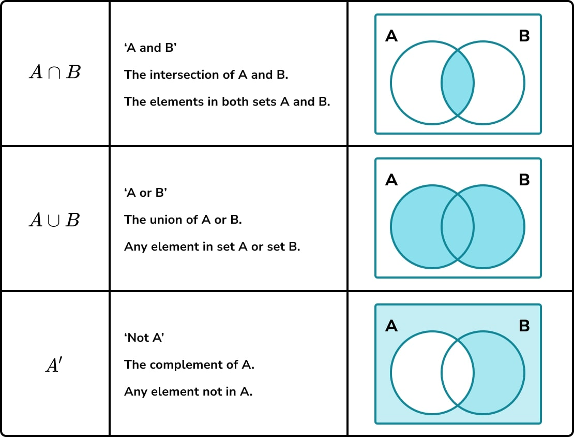

Slide 4
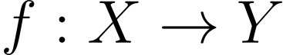
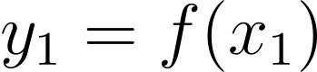
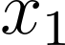
Range
X
Domain
Y
Codomain

Slide 5
S P(S) = 1
A P(A) = 0.1
B P(B) = 0.1
A ∩ B P(A ∩ B) = 0.03

Slide 6
B P(B) = 0.1
A ∩ B P(A ∩ B) = 0.03

Slide 7
B P(B)/P(B) = 0.1/0.1 = 1
A ∩ B P(A ∩ B)/P(B) = P(A | B) = 0.03/0.01 = 0.3

Slide 8
S P(S) = 1
A P(A) = 0.3

Slide 9
S P(S) = 1
A P(A) = 0.1
B P(B) = 0.1
A ∩ B P(A ∩ B) = 0.03

Slide 10
S P(S) = 1
A P(A) = 0.1
B P(B) = 0.1
A ∩ B P(A ∩ B) = 0.01

Slide 11
S P(S) = 1
A P(A) = 0.1
B P(B) = 0.1
A ∩ B P(A ∩ B) = 0

Slide 12
S P(S) = 1
A = B P(A) = P(B) = 0.1
A ∩ B P(A ∩ B) = 0.1

Slide 13
S
A

Slide 14
B₁
B₂
B₃
B₄
A
A ∩ B₁ = ∅
A ∩ B₂
A ∩ B₃
A ∩ B₄ = ∅

Slide 15
S P(S) = 1
A P(A) = 0.1
B P(B) = 0.1
A ∩ B P(A ∩ B) = 0.03

Slide 16
S P(S) = 1
A P(A) = 0.1

Slide 17
S P(S) = 1
A P(A) = 0.1

Slide 18
S P(S) = 1
A P(A) = 0.1
B P(B) = 0.1
A ∩ B P(A ∩ B) = 0.03

Slide 19
S P(S) = 1
A P(A) = 0.1
B P(B) = 0.1
B P(B) = 0.1
A ∩ B P(A ∩ B) = 0.03

Slide 20
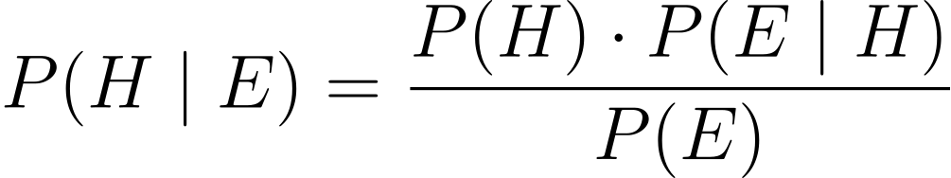
PRIOR
LIKELIHOOD
POSTERIOR
EVIDENCE

Slide 21
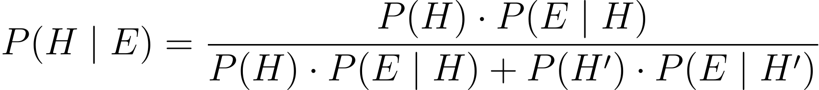
PRIOR
LIKELIHOOD
POSTERIOR
EVIDENCE

Slide 22
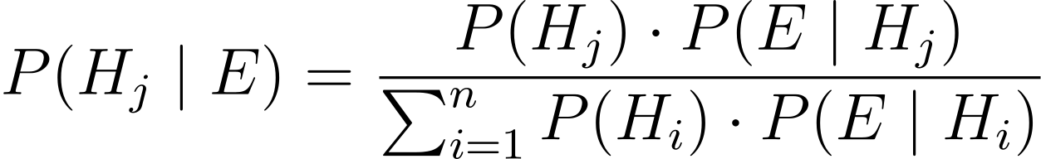
PRIOR
LIKELIHOOD
POSTERIOR
EVIDENCE

Slide 23
POSTERIOR
PRIOR
LIKELIHOOD

Slide 24
PRIOR
LIKELIHOOD
POSTERIOR
EVIDENCE

Slide 25
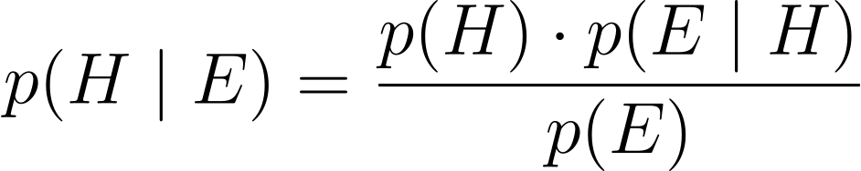
PRIOR
LIKELIHOOD
POSTERIOR
EVIDENCE

Slide 26
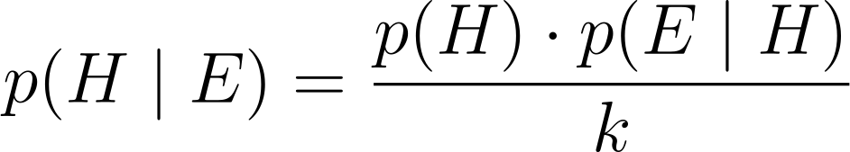
PRIOR
LIKELIHOOD
POSTERIOR
KNOWN NORMALIZING CONSTANT

Slide 27
POSTERIOR
PRIOR
LIKELIHOOD

Slide 28
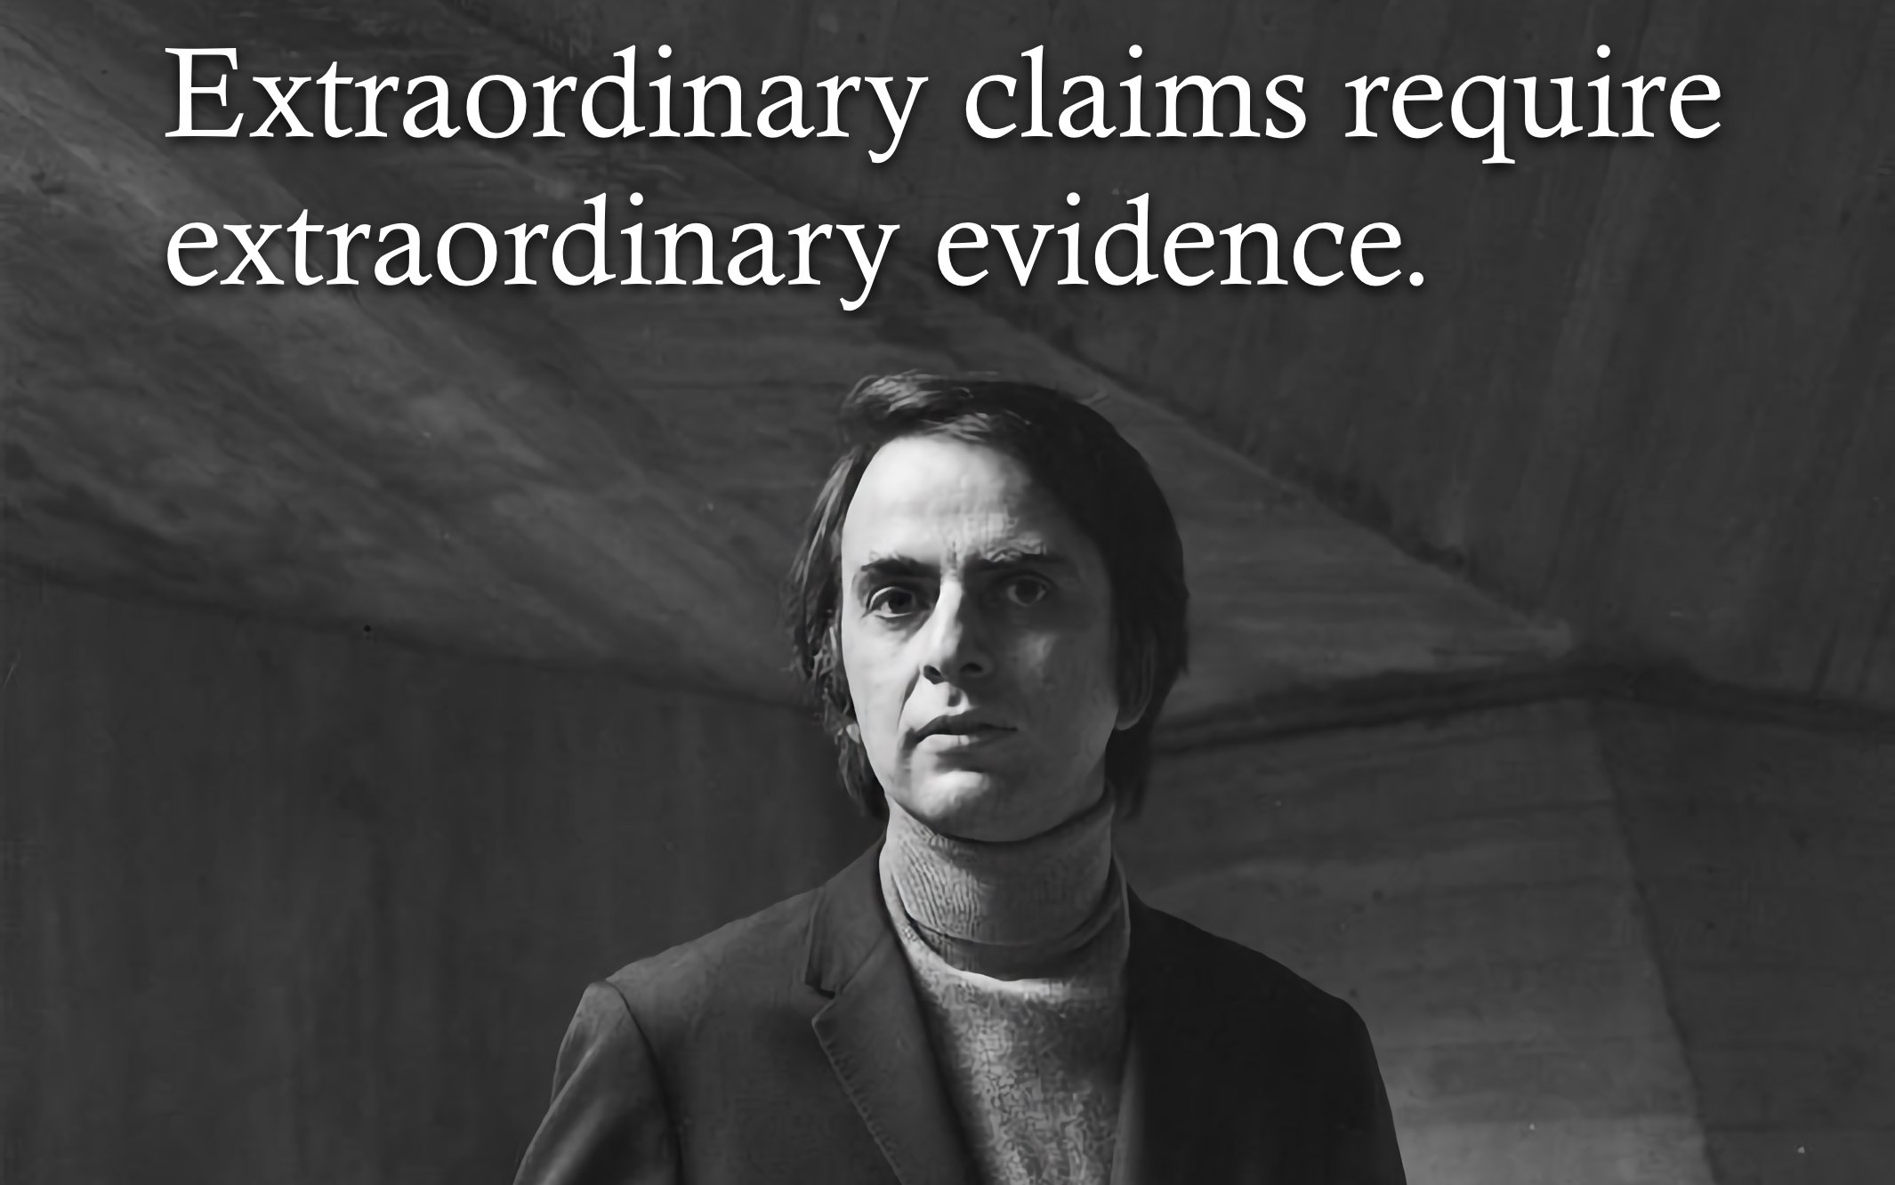
POSTERIOR
PRIOR
LIKELIHOOD

Slide 29
PRIOR
LIKELIHOOD
POSTERIOR
EVIDENCE

Slide 30
LIKELIHOOD
EVIDENCE

Slide 31
LIKELIHOOD
UNKNOWN CONSTANT

Slide 32
LIKELIHOOD
UNKNOWN CONSTANT

Slide 33
LIKELIHOOD FUNCTION
LIKELIHOOD
UNKNOWN CONSTANT

Slide 34
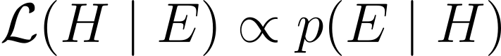
LIKELIHOOD FUNCTION
LIKELIHOOD

Slide 35
Modeling
Premises
Causes
Reasoning
Learning
Conclusion
Effect

Slide 36
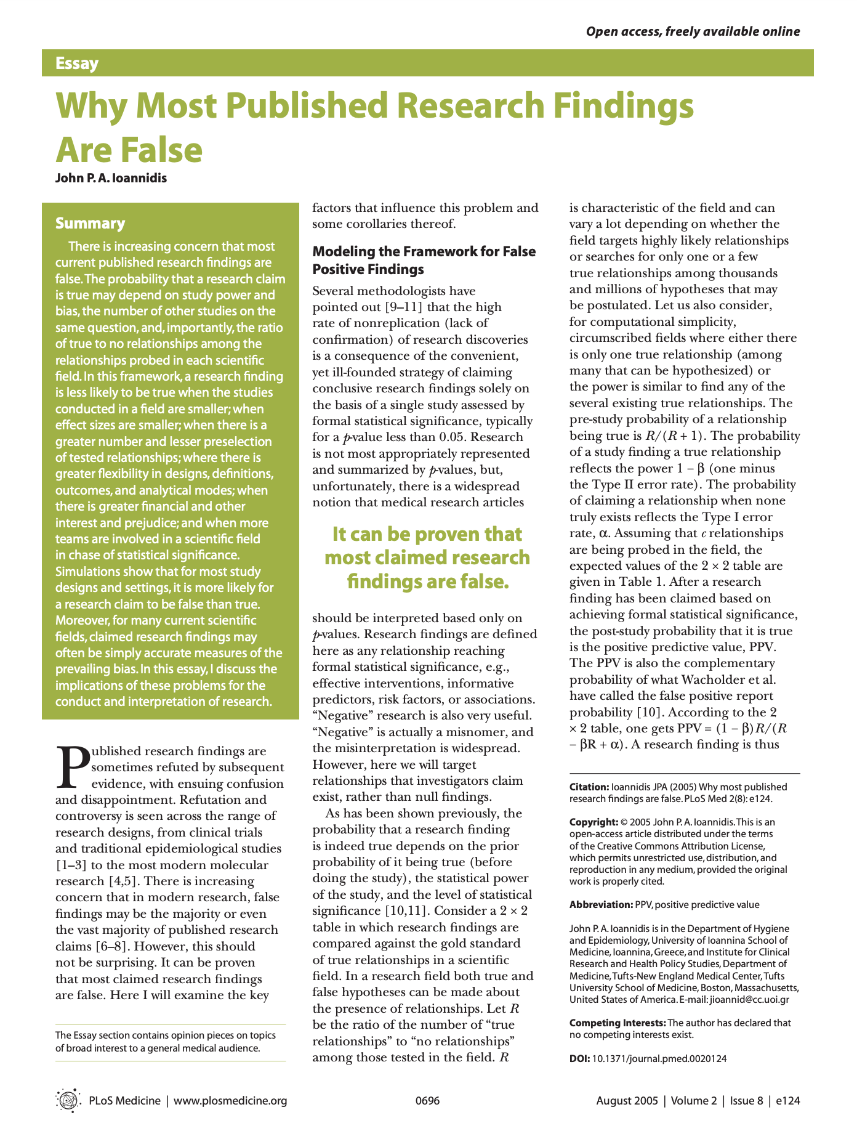
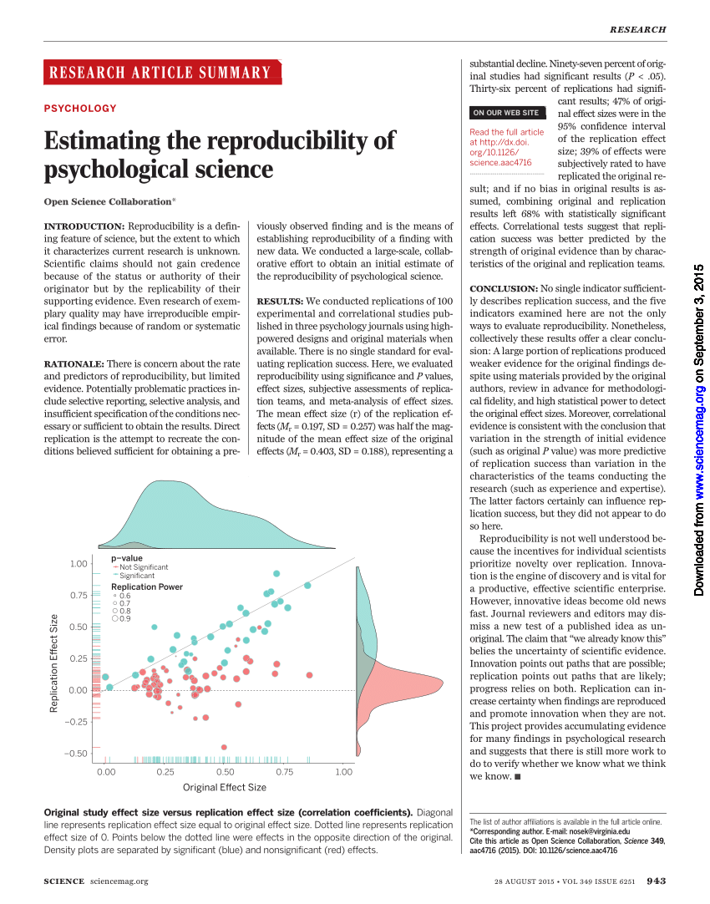

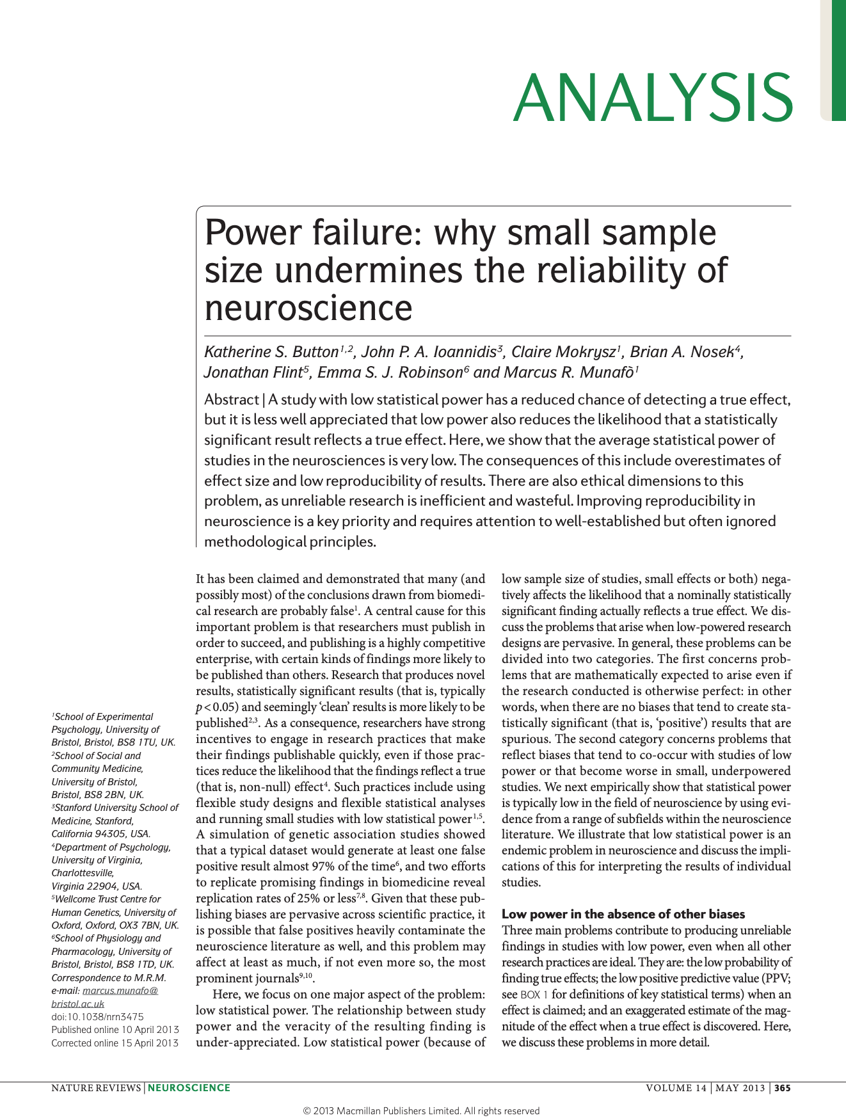

Slide 37
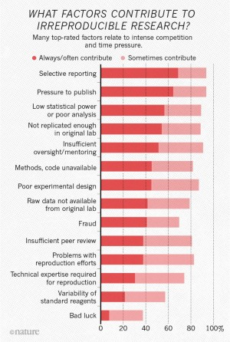
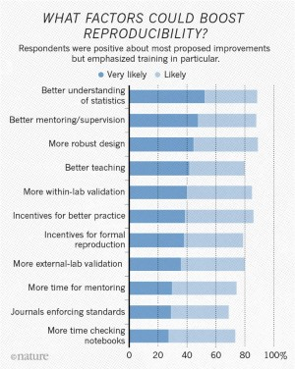
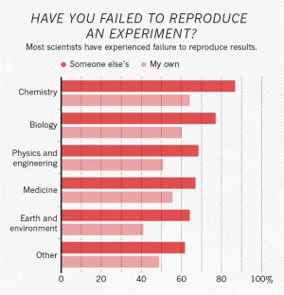

Slide 38
Y = β₀ + β₁X + ε
premises
conclusion
Y = b₀ + b₁X with CI

Slide 40
P₁
P₂
⋮
P_{n}
⎯
C

Slide 41
P₁
P₂
⋮
P_{n}
⎯
C
E
⎯
H
E = P₁ ∧ P₂ ∧ … ∧ P_{n}

Slide 42
P₁
P₂
⋮
P_{n}
⎯
C
E
⎯
H
E = P₁ ∧ P₂ ∧ … ∧ P_{n}
E ⇒ H

Slide 43
P₁
P₂
⋮
P_{n}
⎯
C
Deductive reasoning
E
⎯
H
E ⊨ H
E ⊭ H
E = P₁ ∧ P₂ ∧ … ∧ P_{n}
E ⇒ H

Slide 44
P₁
P₂
⋮
P_{n}
⎯
C
Deductive reasoning
E
⎯
H
V(H | E)
E = P₁ ∧ P₂ ∧ … ∧ P_{n}
E ⇒ H

Slide 45
P₁
P₂
⋮
P_{n}
⎯
C
Deductive reasoning
Inductive reasoning
E
⎯
H
V(H | E)
P(H | E)
E = P₁ ∧ P₂ ∧ … ∧ P_{n}
E ⇒ H

Slide 46

Notes:
A probability model is the triplet (Ω, σ-algebra, P)
Generative vs Discriminative

Slide 47
Replication/Revision/Rejection
Conclusion
L(M|D) ∝ P(D|M) Frequentist
P(M|D) ∝ P(D|M) · P(M) Bayesian
Causal claim
Causal effects Explanations
Causal inference
Data
Model
Inference algorithm
Statistical inference Machine learning
Observations
Predictions
P(D|M)
Natural process
Causal model
DGP model
Probability theory
Inductive reasoning
Real world
Abstract world
Propositional logic Deductive reasoning
Empiricism
Rationalism
Notes:
A probability model is the triplet (Ω, σ-algebra, P)
Generative vs Discriminative

Slide 48
Ω
H

Slide 49
P(H)
Ω
H

Slide 50
P(H | Ω)
Ω
H

Slide 51
P(H)
Ω
H

Slide 52
P(H)
Ω
E

Slide 53
P(H)
P(E)
Ω
E

Slide 54
P(H)
P(E | Ω)
Ω
E

Slide 55
P(H)
P(E)
Ω
E

Slide 56
P(H)
P(E)
Ω
H
E

Slide 57
P(H)
P(E)
Ω
H ∧ E

Slide 58
P(H)
P(E)
P(H ∧ E)
Ω
H ∧ E

Slide 59
P(H)
P(E)
P(H ∧ E | Ω)
Ω
H ∧ E

Slide 60
P(H)
P(E)
P(H ∧ E)
Ω
H ∧ E

Slide 61
P(H)
P(E)
P(H ∧ E)
Ω
H
E

Slide 62
P(H)
P(E)
P(H ∧ E)
Ω
H
E

Slide 63
P(H)
P(E)
P(H ∧ E)
Ω
H ∨ E

Slide 64
P(H)
P(E)
P(H ∧ E)
Ω
H ∨ E
P(P(H ∨ E) = P(H) + P(E) – P(H ∧ E)

Slide 65
P(H)
P(E)
P(H ∧ E)
Ω
H ∨ E
P(P(H ∨ E) = P(H) + P(E) iff H and E are disjoint/mutually exclusive events, i.e., P(H ∧ E) = 0

Slide 66
P(H)
P(E)
P(H ∧ E)
Ω
H
E

Slide 67
P(H)
P(E)
P(H ∧ E)
P(H | E)
Ω
H
E

Slide 68
P(H ∧ E)
P(H)
P(E)
P(H ∧ E)
P(H | E) =
Ω
P(E)
H
E

Slide 69
P(H ∧ E)
P(H)
P(E)
P(H ∧ E)
P(H | E) =
Ω
P(E)
H
E

Slide 70
P(H ∧ E)
P(H)
P(E)
P(H ∧ E)
P(H | E) =
Ω
P(E)
H
E

Slide 71
P(H ∧ E)
P(H)
P(E)
P(H ∧ E)
P(H | E) =
Ω
P(E)
H
E

Slide 72
P(H ∧ E)
P(H)
P(E)
P(H ∧ E)
P(H | E) =
Ω
P(E)
H
E

Slide 73
P(H)
P(E)
P(H ∧ E)
P(H | E)
Ω
H
E

Slide 74
P(H)
P(E)
P(H ∧ E)
P(H | E)
P(E | H)
Ω
H
E

Slide 75
P(H ∧ E)
P(H)
P(E)
P(H ∧ E)
P(H | E)
P(E | H) =
Ω
P(H)
H
E

Slide 76
P(H ∧ E)
P(H)
P(E)
P(H ∧ E)
P(H | E)
P(E | H) =
Ω
P(H)
H
E

Slide 77
P(H ∧ E)
P(H)
P(E)
P(H ∧ E)
P(H | E)
P(E | H) =
Ω
P(H)
H
E

Slide 78
P(H ∧ E)
P(H)
P(E)
P(H ∧ E)
P(H | E)
P(E | H) =
Ω
P(H)
H
E

Slide 79
P(H ∧ E)
P(H)
P(E)
P(H ∧ E)
P(H | E)
P(E | H) =
Ω
P(H)
H
E

Slide 80
P(H)
P(E)
P(H ∧ E)
P(H | E)
P(E | H)
Ω
H
E

Slide 81
P(H)
P(E)
P(H ∧ E)
P(H | E)
P(E | H)
Ω
H
E
P(H) · P(E | H)
= P(H | E) =
P(E)

Slide 82
P(H)
P(E)
P(H ∧ E)
P(H | E)
P(E | H)
Ω
H
E
P(H) · P(E | H)
= P(H | E) =
P(E)

Slide 83
P(H)
P(E)
P(H ∧ E)
P(H | E)
P(E | H)
Ω
H
E
x
P(H) · P(E | H)
= P(H | E) =
=
P(E)

Slide 84
P(H)
P(E)
P(H ∧ E)
P(H | E)
P(E | H)
Ω
H
E
x
P(H) · P(E | H)
= P(H | E) =
=
P(E)

Slide 85
P(H)
P(E)
P(H ∧ E)
P(H | E)
P(E | H)
Ω
H
E
x
P(H) · P(E | H)
= P(H | E) =
=
P(E)

Slide 86
P(H)
P(E)
P(H ∧ E)
P(H | E)
P(E | H)
Ω
H
E
x
P(H) · P(E | H)
= P(H | E) =
=
P(E)

Slide 87
P(H)
P(E)
P(H ∧ E)
P(H | E)
P(E | H)
Ω
H
E
P(H) · P(E | H)
= P(H | E) =
=
P(E)

Slide 88
P(H)
P(E)
P(H ∧ E)
P(H | E)
P(E | H)
Ω
H
E
P(H) · P(E | H)
= P(H | E) =
=
P(E)

Slide 89
Ω
E

Slide 90
Ω
E

Slide 91
Ω
P₁

Slide 92
Ω
P₂

Slide 93
Ω
P₃

Slide 94
Ω
P₁
P₂
P₃
P₁, P₂ and P₃ are disjoint and exhaustive events (i.e., partitions of the sample space) P(P₁) + P(P₂) + P(P₃) = P(Ω) = 1

Slide 95
Ω
P₁ ∧ E

Slide 96
Ω
P₂ ∧ E

Slide 97
Ω
P₃ ∧ E

Slide 98
Ω
P₁ ∧ E
P₂ ∧ E
P₃ ∧ E

Slide 99
Ω
P₁ ∧ E
P₂ ∧ E
P₃ ∧ E
P(E) = P(P₁ ∧ E) + P(P₂ ∧ E) + P(P₃ ∧ E)

Slide 100
Ω
P₁ ∧ E
P₂ ∧ E
P₃ ∧ E
P(E) = P(P₁ ∧ E) + P(P₂ ∧ E) + P(P₃ ∧ E)
Law of total probability

Slide 101
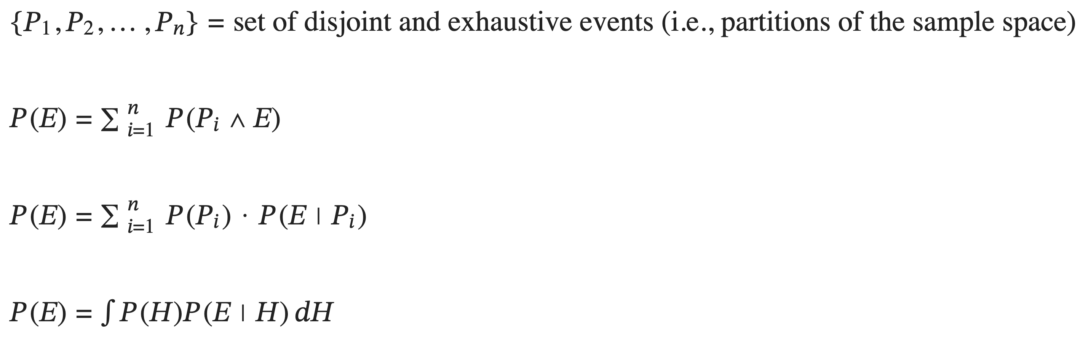
Ω
P₁ ∧ E
P₂ ∧ E
P₃ ∧ E
P(E) = P(P₁ ∧ E) + P(P₂ ∧ E) + P(P₃ ∧ E)
Law of total probability

Slide 102
Ω
P₁ ∧ E
P₂ ∧ E
P₃ ∧ E
P(E) = P(P₁ ∧ E) + P(P₂ ∧ E) + P(P₃ ∧ E)
Law of total probability

Slide 103
Ω
P₁ ∧ E
P₂ ∧ E
P₃ ∧ E
P(E) = P(P₁) · P(E | P₁) + P(P₂) · P(E | P₂) + P(P₃) · P(E | P₃)
Law of total probability

Slide 104
P(H)
P(E)
P(H ∧ E)
P(H | E)
P(E | H)
Ω
H
E

Slide 105
P(H)
P(E)
P(H ∧ E)
P(H | E)
P(E | H)
Ω
H
E
Ω
H

Slide 106
P(H)
P(E)
P(H ∧ E)
P(H | E)
P(E | H)
Ω
H
E
Ω
¬H

Slide 107
P(H)
P(E)
P(H ∧ E)
P(H | E)
P(E | H)
Ω
H
E
Ω
¬H
P(¬H) = P(Ω) - P(H) = 1 – P(H)

Slide 108
P(H)
P(E)
P(H ∧ E)
P(H | E)
P(E | H)
Ω
H
E
Ω
H

Slide 109
P(H)
P(E)
P(H ∧ E)
P(H | E)
P(E | H)
Ω
H
E
Ω
Ω
H
H ∧ E

Slide 110
P(H)
P(E)
P(H ∧ E)
P(H | E)
P(E | H)
Ω
H
E
Ω
¬H

Slide 111
P(H)
P(E)
P(H ∧ E)
P(H | E)
P(E | H)
Ω
H
E
Ω
¬H
Ω
¬H ∧ E

Slide 112
P(H)
P(E)
P(H ∧ E)
P(H | E)
P(E | H)
Ω
H
E
Ω
H ∧ E
¬H ∧ E
P(E) = P(H ∧ E) + P(¬H ∧ E)

Slide 113
P(H)
P(E)
P(H ∧ E)
P(H | E)
P(E | H)
Ω
H
E
Ω
H ∧ E
¬H ∧ E
P(E) = P(H) · P(E | H) + P(¬H) · P(E | ¬H)

Slide 114

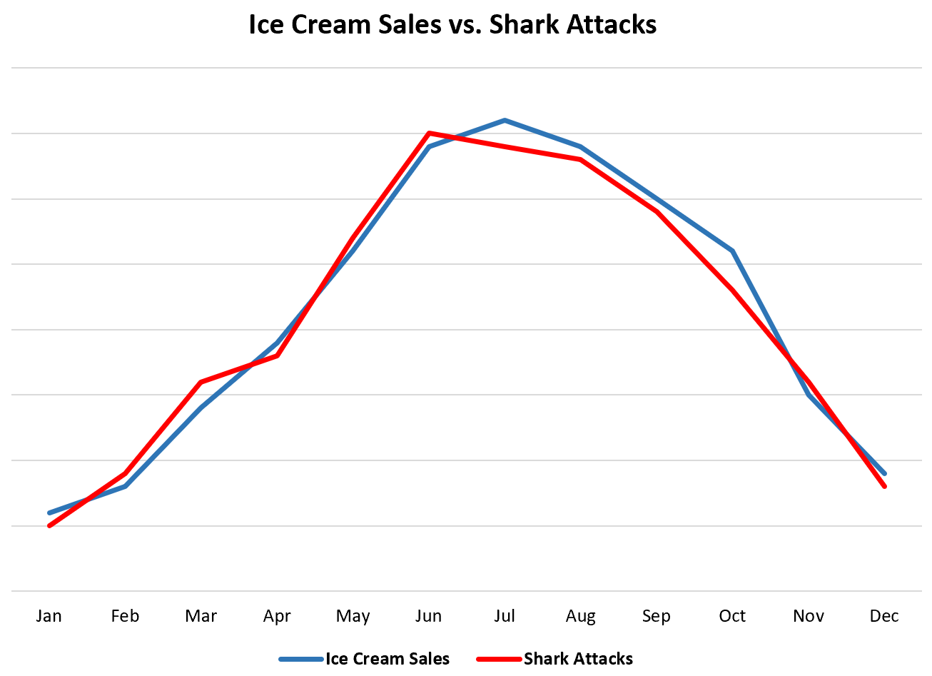

Slide 115


Slide 116
🦈 ≠ 𝑓(🍦)

Slide 117


🦈 = 𝑓(🌪️)

Slide 118

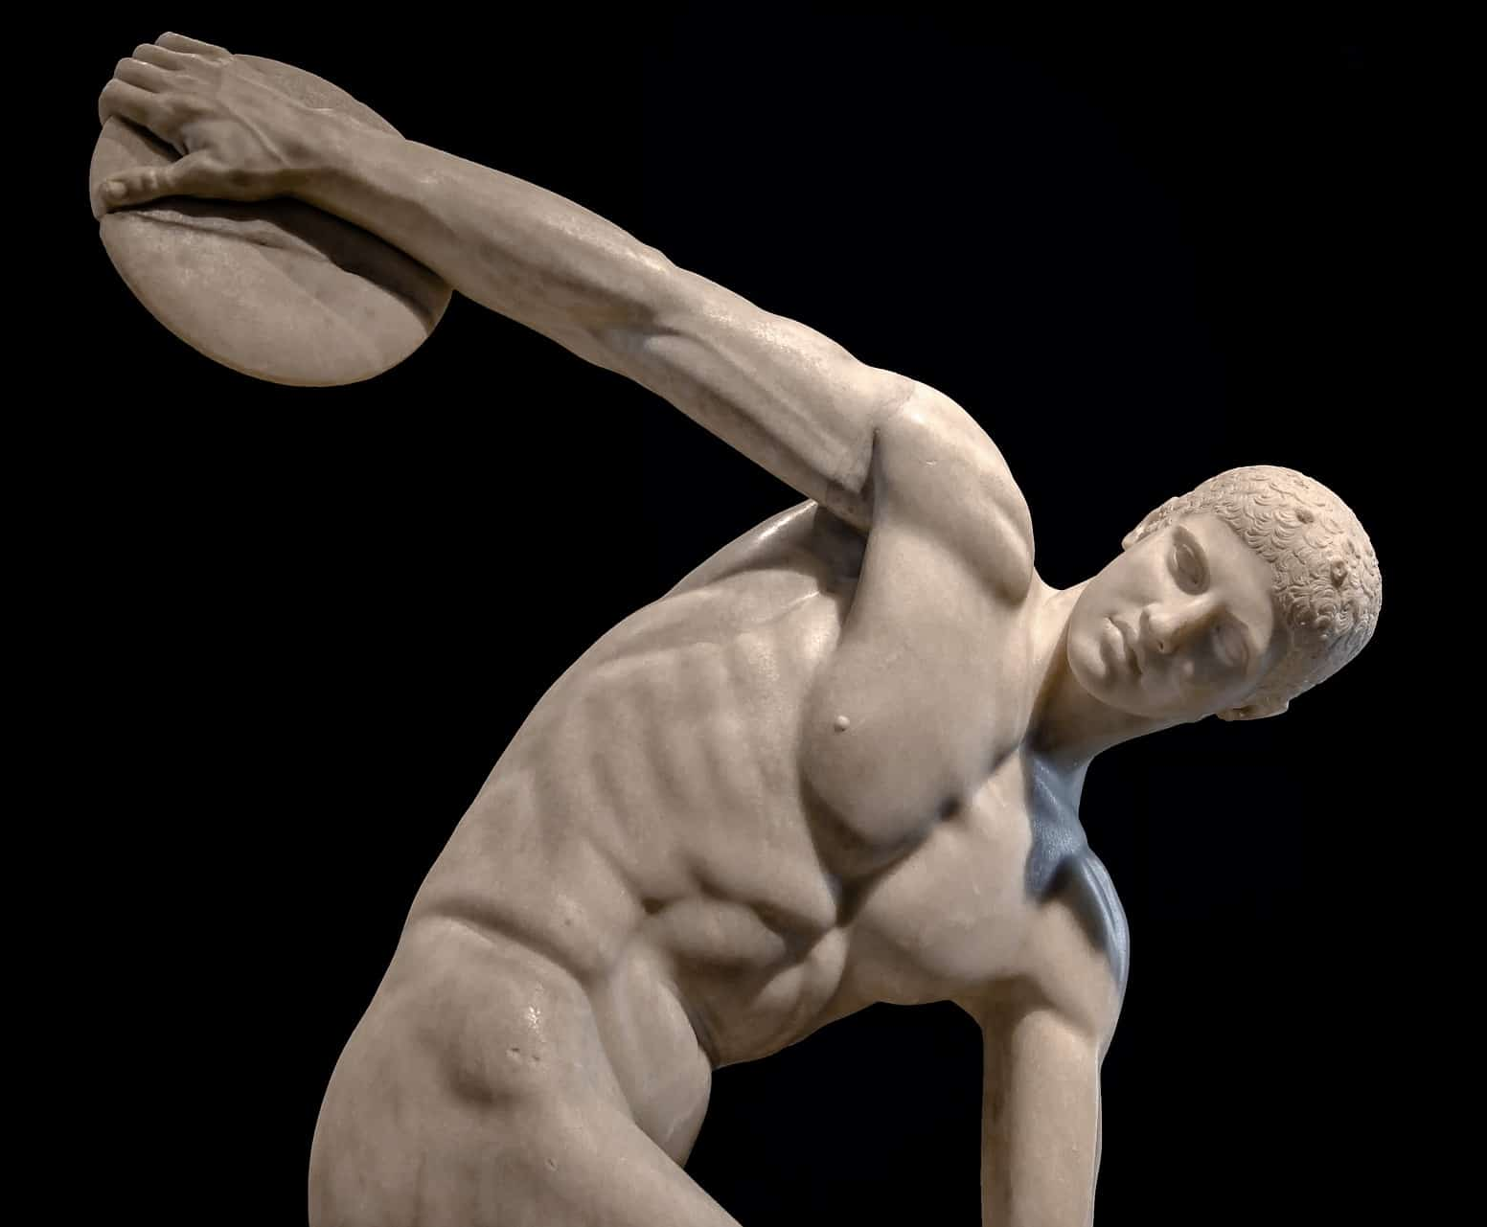

Slide 119

🦈 = 𝑓(🌪️)

Slide 120



Slide 121
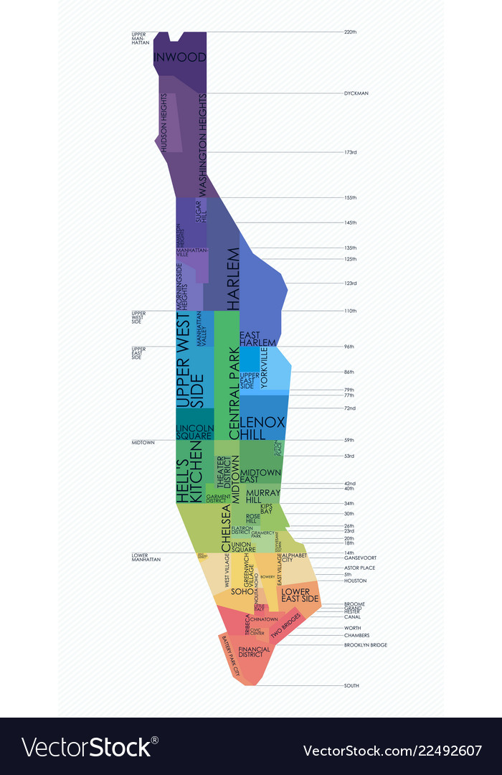
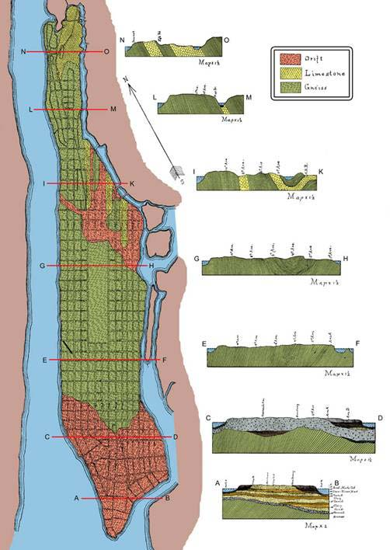

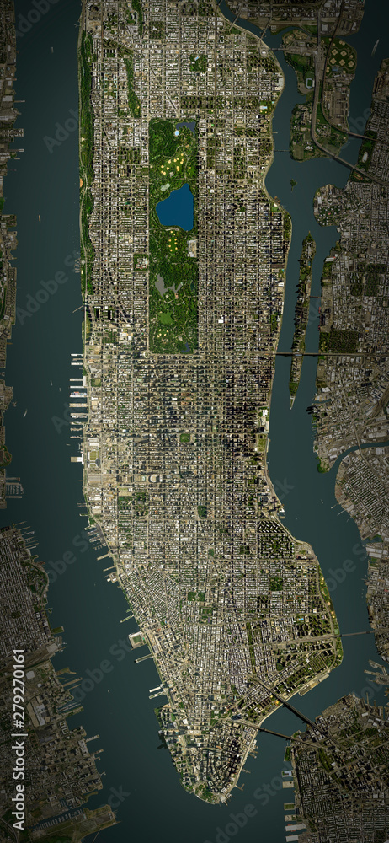
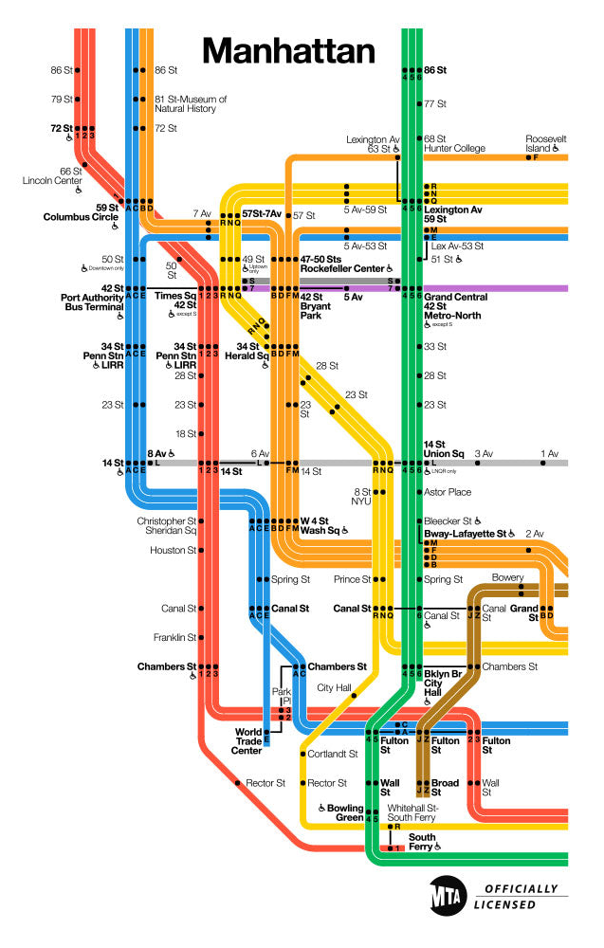
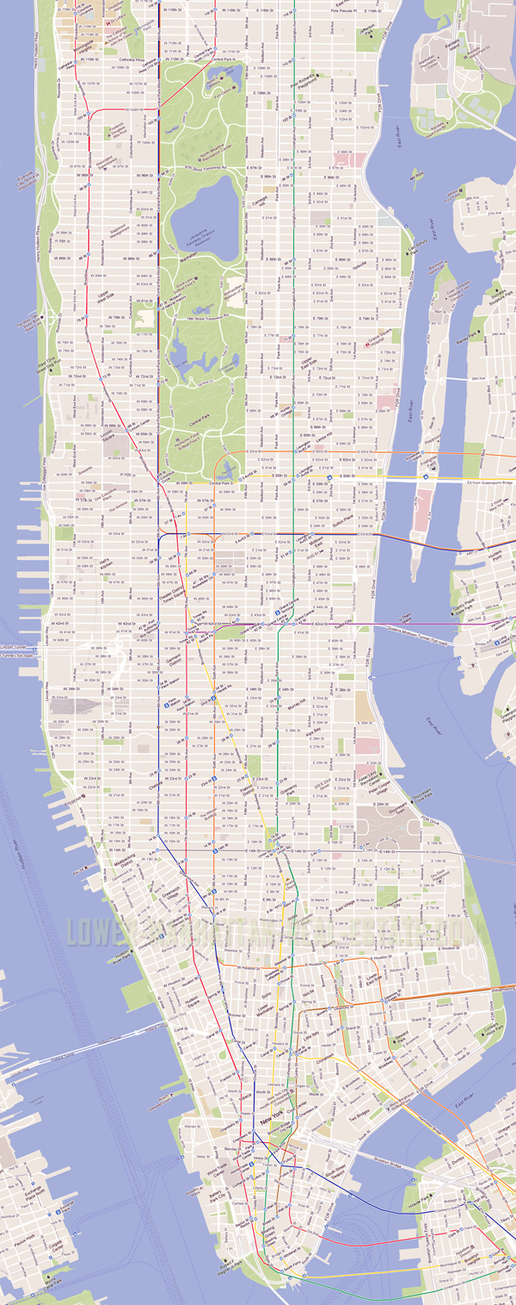

Slide 122
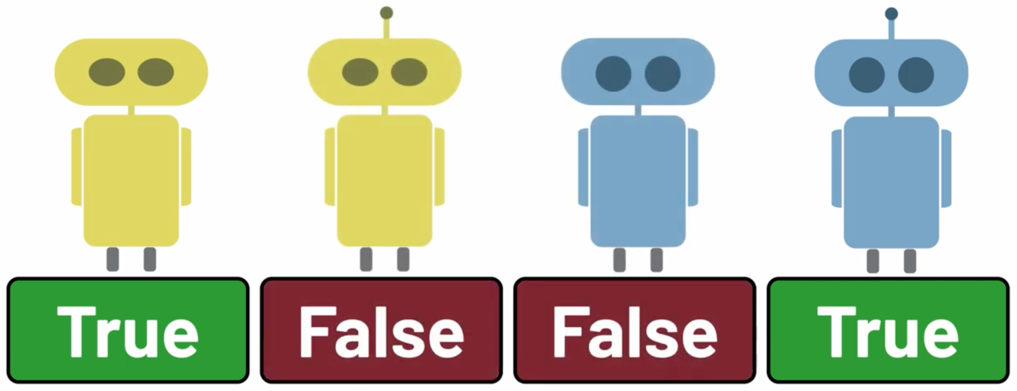
”Does the robot have an antenna?” (variable)
¬A
True
False

Slide 123
”The robot 🤔 an antenna” (variable)
¬A
True
False

Slide 124
”The robot has an antenna” (proposition)
¬A = a
True
False

Slide 125
”The robot has an antenna” (proposition)
¬A = T
True
False

Slide 126
”The robot has an antenna” (proposition)
¬A
True
False

Slide 127
”The robot does not have an antenna” (proposition)
¬A = F
True
False
True
False

Slide 128
”The robot does not have an antenna” (proposition)
¬A
True
False
True
False

Slide 129
”Is the robot blue?” (variable)
¬B
True
False

Slide 130
”The robot 🤔 blue” (variable)
¬B
True
False

Slide 131
”The robot is blue” (proposition)
¬B = b
True
False

Slide 132
”The robot is blue” (proposition)
¬B = T
True
False

Slide 133
”The robot is blue” (proposition)
¬B
True
False

Slide 134
”The robot is not blue” (proposition)
¬B = F
True
False
True
False

Slide 135
”The robot is not blue” (proposition)
¬B
True
False
True
False

Slide 136
”What is the sex of the robot?” (variable)
¬S
♂
↓
♀
＋
⚤
＋
↓

Slide 137
”The sex of the robot is 🤔” (variable)
¬S
♂
↓
♀
＋
⚤
＋
↓

Slide 138
”The sex of the robot is s” (proposition)
¬S = s
♂
↓
♀
＋
⚤
＋
↓

Slide 139
”The sex of the robot is s” (proposition)
¬s
♂
↓
♀
＋
⚤
＋
↓

Slide 140
”The sex of the robot is ♂” (proposition)
¬S = ♂
♂ = 1
True
↓
♀ = 2
False
＋
⚤ = 3
False
＋
↓

Slide 141
”What is the height (cm) of the robot?” (variable)
¬H
10
20
30

Slide 142
”The height of the robot is 🤔 cm” (proposition)
¬H
10
20
30

Slide 143
”The height of the robot is h cm” (proposition)
¬H = h
10
20
30

Slide 144
”The height of the robot is h cm” (proposition)
¬h
10
20
30

Slide 145
”The height of the robot is 10 cm” (proposition)
¬H = 10
True
10
False
20
False
30

Slide 146
”What is the weight (g) of the robot?” (variable)
¬W
20
40
60

Slide 147
”The weight of the robot is 🤔 g” (variable)
¬W
20
40
60

Slide 148
”The weight of the robot is w g” (proposition)
¬W = w
20
40
60

Slide 149
”The weight of the robot is w g” (proposition)
¬w
20
40
60

Slide 150
”The weight of the robot is 20 g” (proposition)
¬W = 20
True
20
False
40
False
60

